Slide 1

MODULE 3: PROGRAMMING FOR BIOLOGICAL DATA
Sanger Sequencing Analysis
Chromatograms, Quality Scores & sangeranalyseR
Instructor: Dr. Haogao Gu | Date: February 4, 2026

Slide 2








Learning Objectives
Sanger
Chromatograms
Phred
sangeranalyseR
Understand the principles of Sanger sequencing and chain termination.
Interpret trace files (.ab1) and identify common artifacts.
Calculate and apply Phred quality scores (Q20, Q30).
Process, trim, and assemble sequences using Bioconductor.

Slide 3

Part 1: The Anatomy of a Chromatogram
From Fluorescent Peaks to DNA Sequence

Slide 4
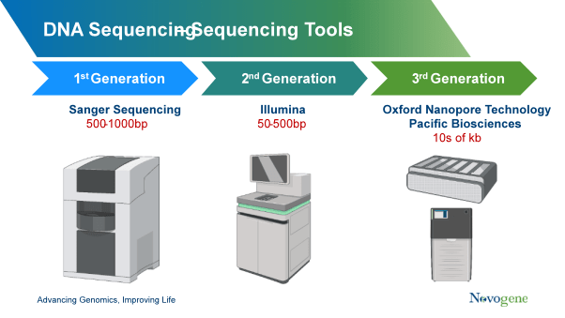

Sanger Sequencing History
The Gold Standard
Developed by Frederick Sanger in 1977.
•
Won Nobel Prize in Chemistry (1980).
•
Known as "Chain Termination" method.
Modern Use
•
Confirming mutations found by NGS.
•
Sequencing single genes (e.g., 16S rRNA).
•
Validating cloning results.

Slide 5


How It Works
The Ingredients
The Process
•
Template DNA
1.
Synthesis starts.
•
Primer
2.
Random incorporation of a ddNTP stops the chain.
•
DNA Polymerase
3.
Fragments of all lengths are produced.
•
dNTPs (Normal nucleotides)
4.
Separated by Capillary Electrophoresis.
•
ddNTPs (Fluorescent Terminators)
5.
Laser detects the color of the last base.

Slide 6
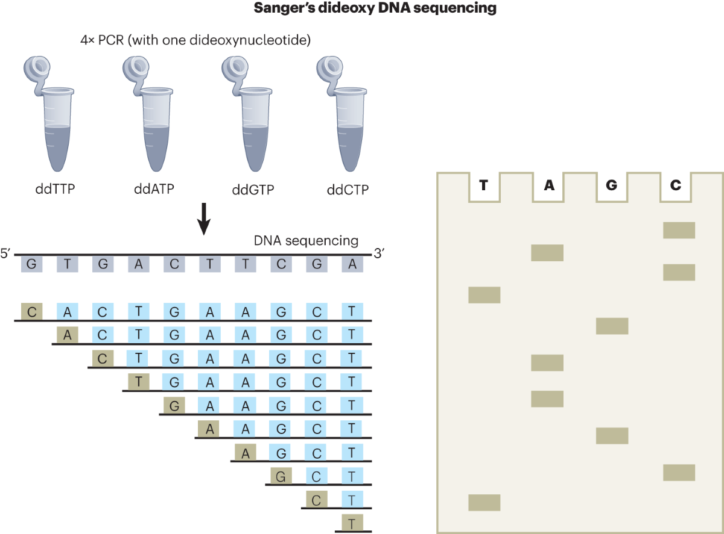
Dideoxynucleotides (ddNTPs)
The key to the method is the missing 3'-OH group.
Without it, the DNA polymerase cannot add the next nucleotide.
Terminator | Color
ddATP | Green
ddTTP | Red
ddGTP | Black
ddCTP | Blue

Slide 7
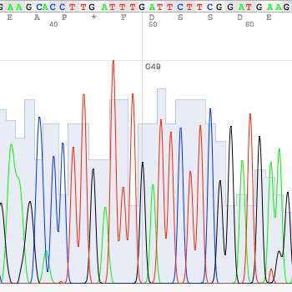
What is a Chromatogram?
The raw data file (.ab1) contains the fluorescence signal trace.
•
X-axis: Time / Position.
•
Y-axis: Fluorescence Intensity.
•
Peaks: Represents a base call.

Slide 8


Reading a Chromatogram
Good Trace
Bad Trace
•
Sharp, defined peaks.
•
Overlapping "mushy" peaks.
•
Even spacing.
•
Variable spacing.
•
Low background noise.
•
High background baseline.
•
High signal intensity.
•
Mixed signals (two peaks at once).

Slide 9
Common Chromatogram Issues
Issue | Location | Cause
Dye Blobs | Start (5') | Unincorporated dye terminators not removed.
Signal Decay | End (3') | Depletion of reagents; long fragments difficult to resolve.
Mixed Peaks | Variable | Heterozygous mutation or sample contamination.

Slide 10

Phred Quality Scores
A standardized metric to quantify base call confidence.
Developed by Phil Green (University of Washington).

Slide 11
Interpreting Phred Scores
Q Score | Error Probability | Accuracy
Q10 | 1 in 10 | 90%
Q20 | 1 in 100 | 99%
Q30 | 1 in 1,000 | 99.9%
Q40 | 1 in 10,000 | 99.99%
Rule of Thumb: Q20 is the minimum for reliable data.

Slide 12
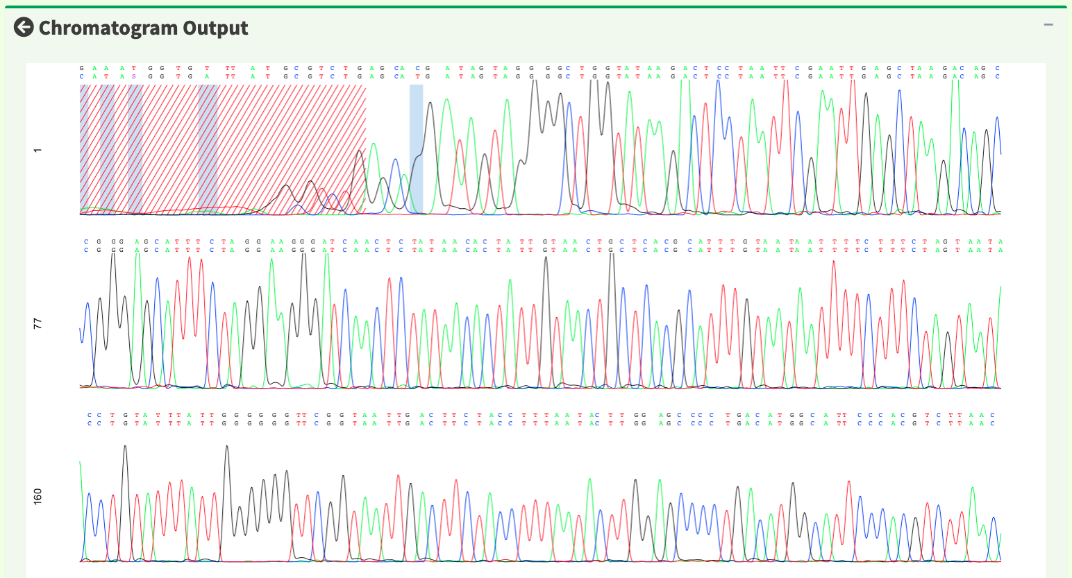
Typical Quality Profile
The "Frown" Shape
Sanger reads typically show:
•
Start (5'): Lower quality due to primer effects and dye blobs.
•
Middle: High quality, reliable sequence.
•
End (3'): Declining quality as signal weakens and resolution drops.

Slide 13
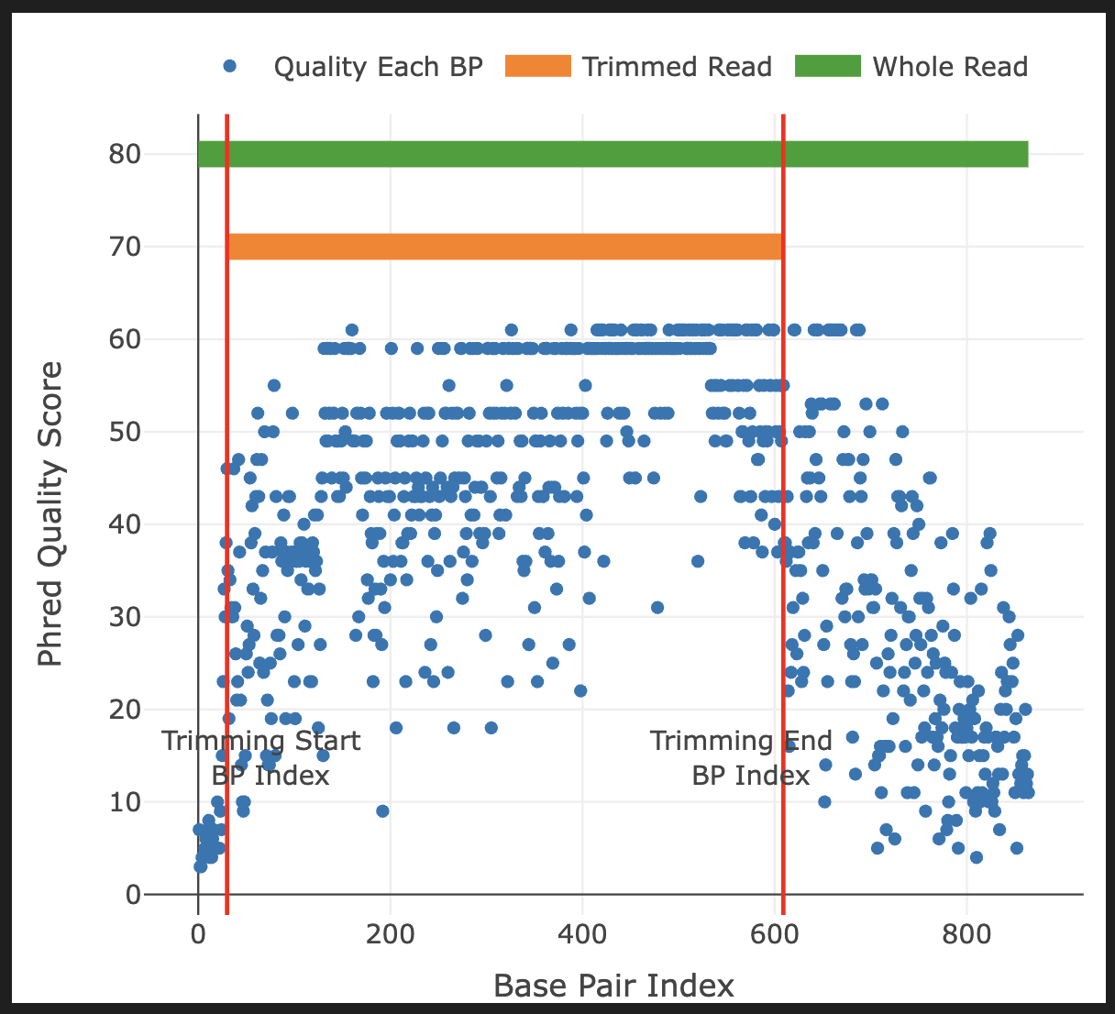

Slide 14






Why Quality Trimming?
Errors
Alignment
Solution
Low-quality bases lead to false mutation calls.
Noisy ends prevent accurate alignment to reference genomes.
Trim the unreliable ends to keep only the high-quality middle.

Slide 18

Part 2: The sangeranalyseR Package
Automated Analysis in R

Slide 19

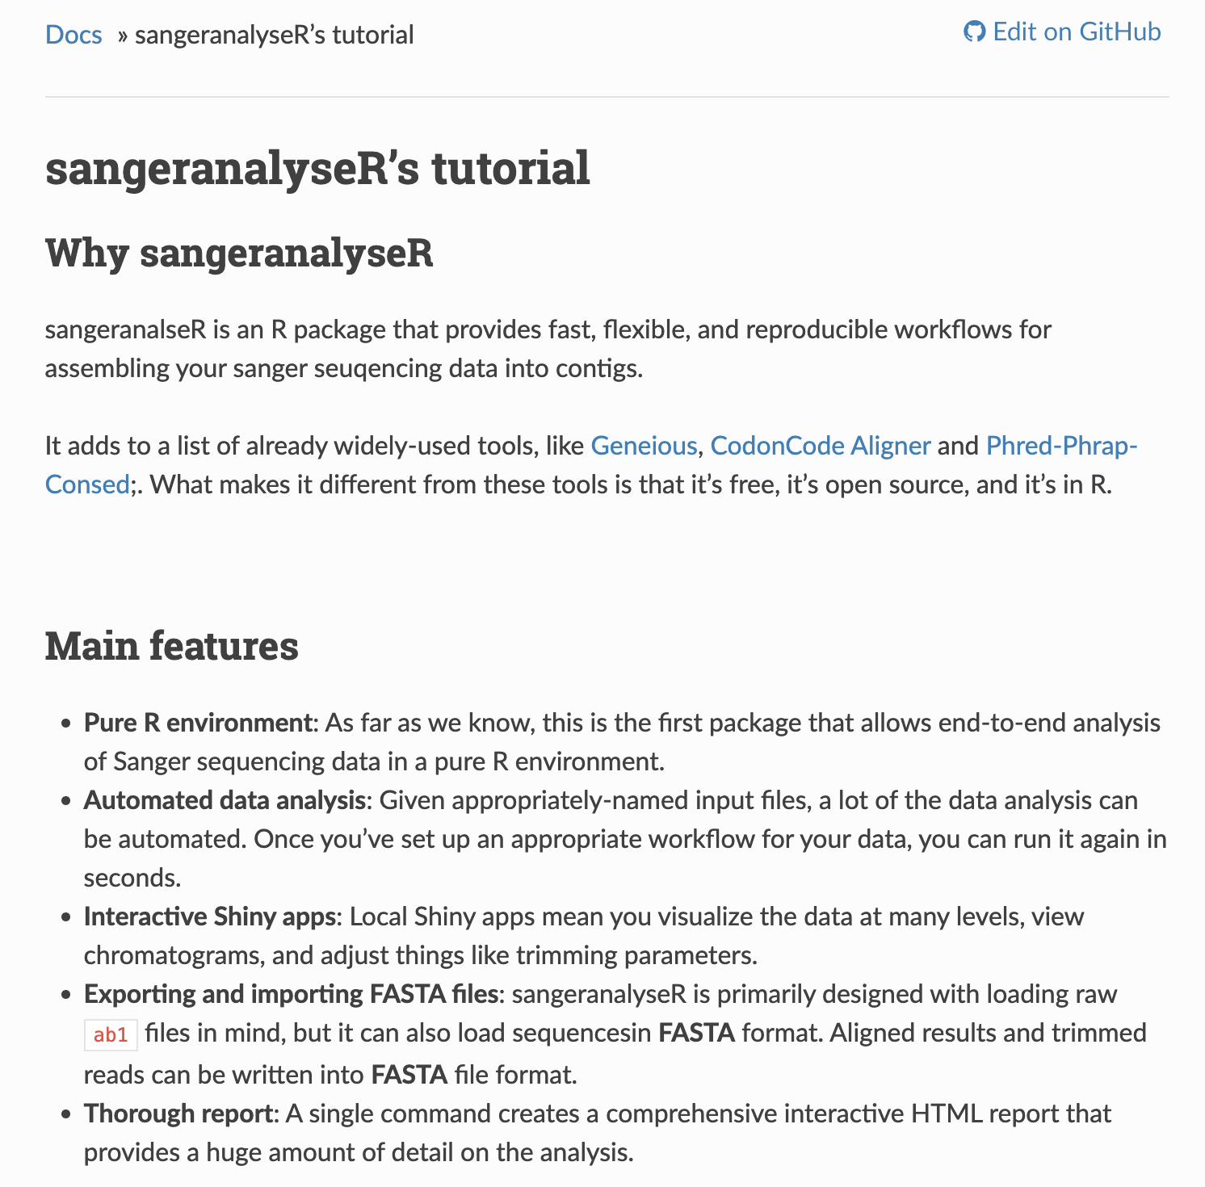

sangeranalyseR
Features
•
Bioconductor package.
•
Reads .ab1 files directly.
•
Visualizes chromatograms and quality.
•
Automated trimming (Mott's Algorithm).
•
Contig assembly (Forward + Reverse).
https://sangeranalyser.readthedocs.io/en/latest/content/quickstart.html

Slide 20
Loading an AB1 File
library(sangeranalyseR) # Create SangerRead object my_read <- SangerRead( readFileName = "sample_1.ab1", readFeature = "Forward Read" ) # View summary my_read

Slide 21
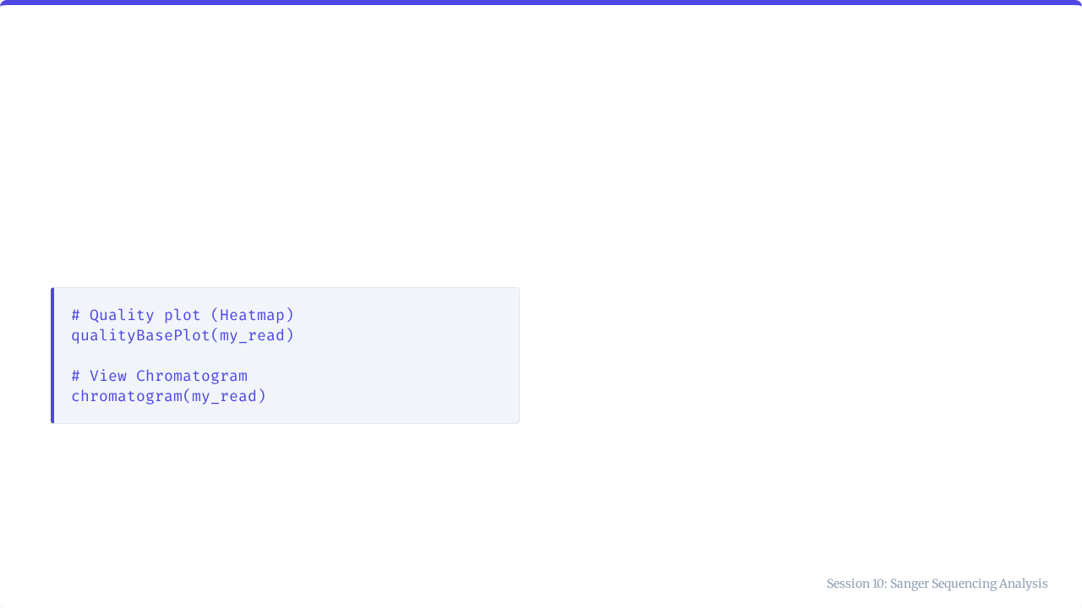
Visualizing Quality
These functions generate interactive plots to inspect signal strength and base call confidence.

Slide 22
Extracting Sequences
# Get raw sequence (Untrimmed) primarySeq(my_read, trim = FALSE) # Get trimmed sequence (Clean) primarySeq(my_read, trim = TRUE) # Get quality scores rawSeqQuality(my_read)

Slide 23


Mott's Trimming Algorithm
The Logic
The Result
1.
Set an error probability limit (e.g., 0.05).
This dynamic method trims poor quality regions from both ends while preserving the high-quality core.
2.
Calculate score: Limit - P_error.
3.
Calculate cumulative sum across sequence.
4.
Identify the substring with the maximum cumulative score.

Slide 24
Trimming Parameters
my_read <- SangerRead( readFileName = "sample.ab1", TrimmingMethod = "M1", # Mott's Algorithm M1TrimmingCutoff = 0.0001, # Stringency (Lower = Stricter) baseNumPerRow = 100 # Formatting )

Slide 25
Quality Statistics
# Extract quality vector quals <- rawSeqQuality(my_read) # Calculate metrics mean(quals) # Average quality sum(quals >= 20) # Count of good bases length(quals) # Read length

Slide 26
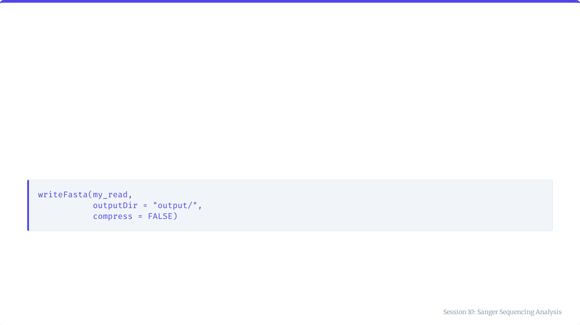
Exporting to FASTA
Once trimmed, save your clean sequence for downstream analysis.

Slide 27
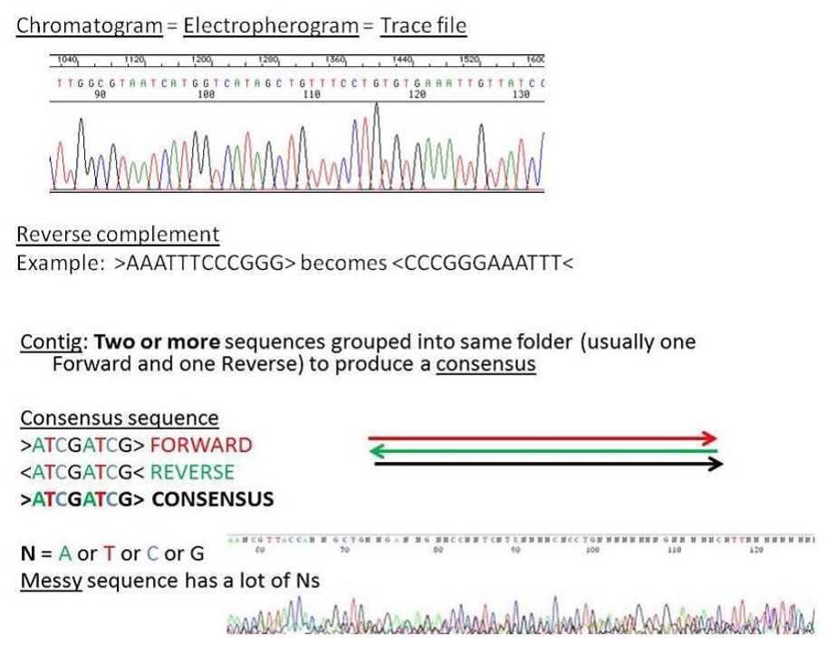
Building Contigs
Forward + Reverse
Sequencing both strands provides confirmation.
A Contig is the consensus sequence built by aligning overlapping forward and reverse reads.

Slide 28
Contig Assembly Code
# Load reads into a contig my_contig <- SangerContig( parentDirectory = "data/", FASTA_File = "reference.fasta", contigName = "Gene_X" ) # Extract consensus consensusString(my_contig)

Slide 29
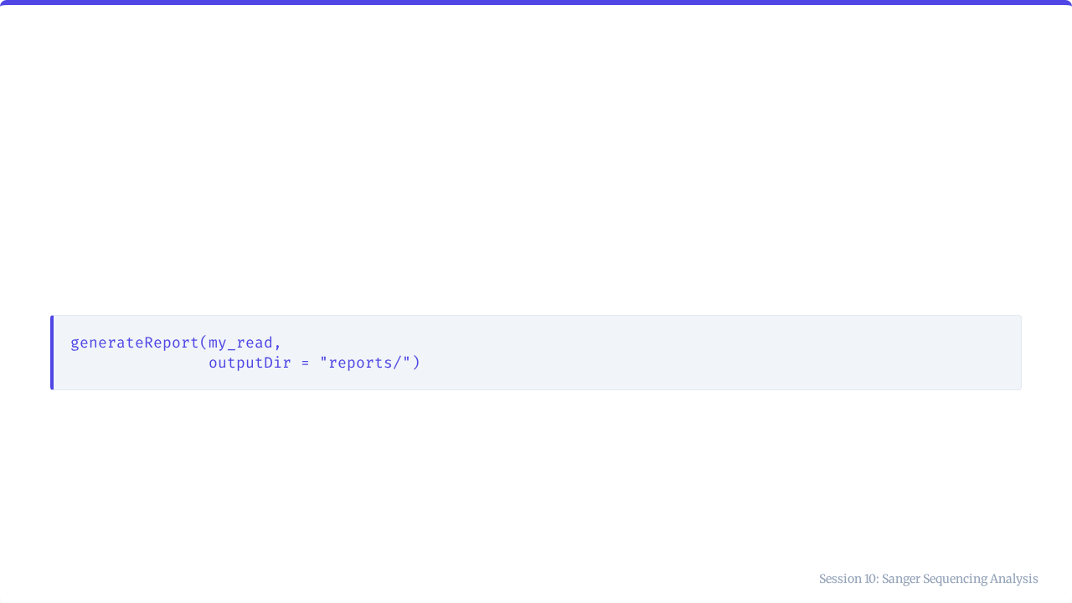
Generating Reports
Create a comprehensive HTML report for documentation.
Includes: Chromatogram, trimming points, quality stats, and sequence text.

Slide 30




Sanger Analysis Best Practices
👀
🛑
✂️
🔄
Visual Check
Threshold
Trim
Bi-directional
Always inspect the chromatogram manually.
Use Q20 as the minimum for trusted bases.
Always trim poor quality ends.
Sequence Fwd & Rev for critical samples.

Slide 31
Key Takeaways
•
Sanger Sequencing is the gold standard for validation.
•
Phred Scores (Q) measure accuracy logarithmically.
•
Quality Profile usually dips at the ends.
•
sangeranalyseR automates loading, trimming, and reporting.
•
Contigs combine Fwd/Rev reads for higher confidence.

Slide 32

Tutorial 10
Processing Sanger Data
Open your R environment

Slide 33
Tutorial 10: Processing Sanger Data
Quality Analysis & Trimming

Slide 34
Your Scenario
The Task
You have received Sanger sequencing data for a viral sample.
Steps:
1.
Simulate data.
2.
Analyze quality profile.
3.
Calculate stats.
4.
Trim low-quality ends.

Slide 35
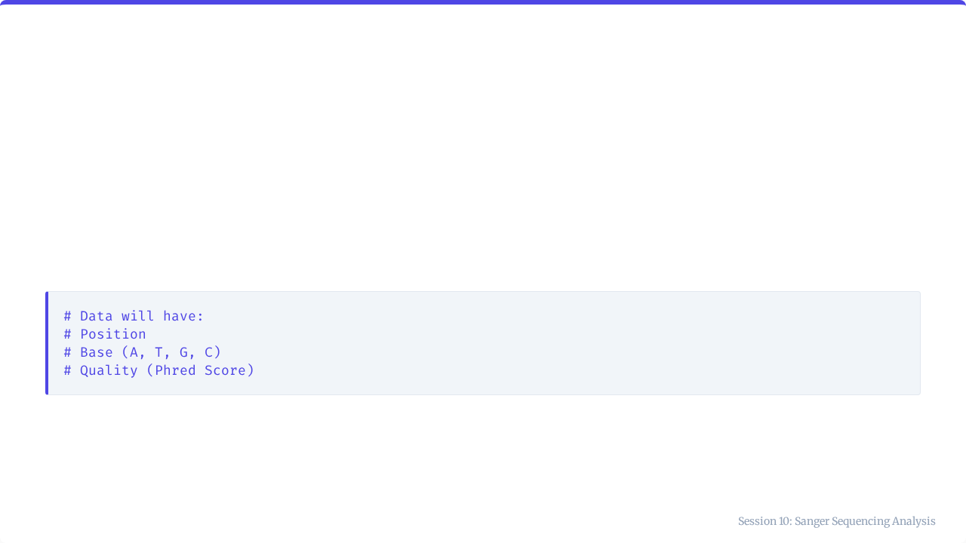
Step 1: Simulate Data
Run the provided code to generate a data frame with sequence and quality scores.

Slide 36
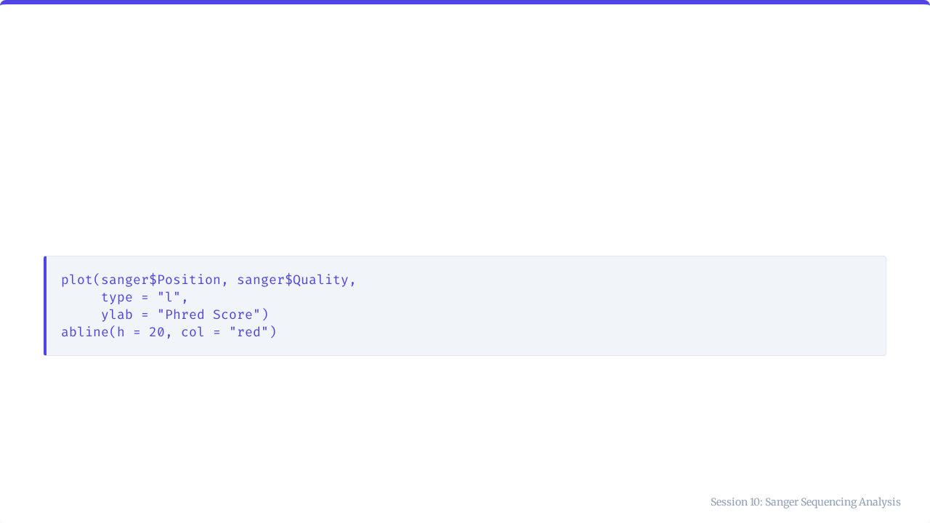
Step 2: Visualize Quality
Plot the quality score across the sequence.
Look for the "frown" shape: low ends, high middle.

Slide 37
Step 3: Quality Stats
# TODO: Fill in mean_qual <- mean(sanger$...) bases_q20 <- sum(sanger$Quality >= ...)

Slide 38
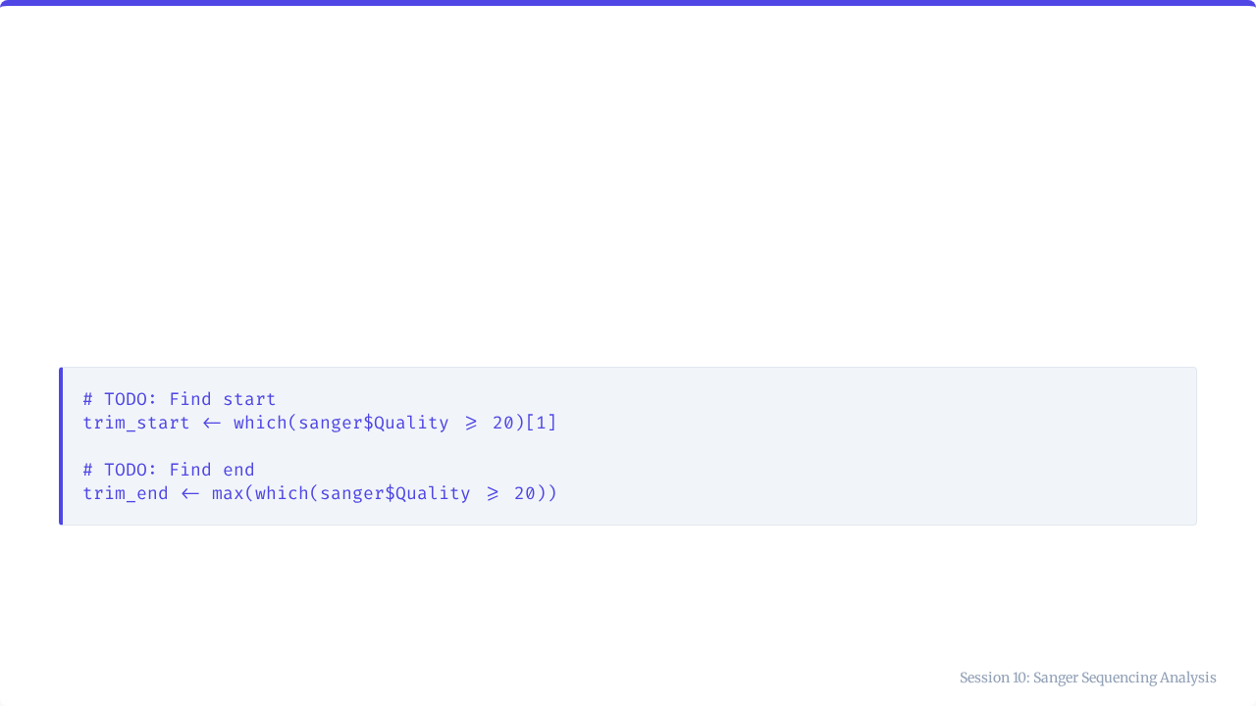
Step 4: Quality Trimming
Find the first and last position where quality meets the threshold.

Slide 39
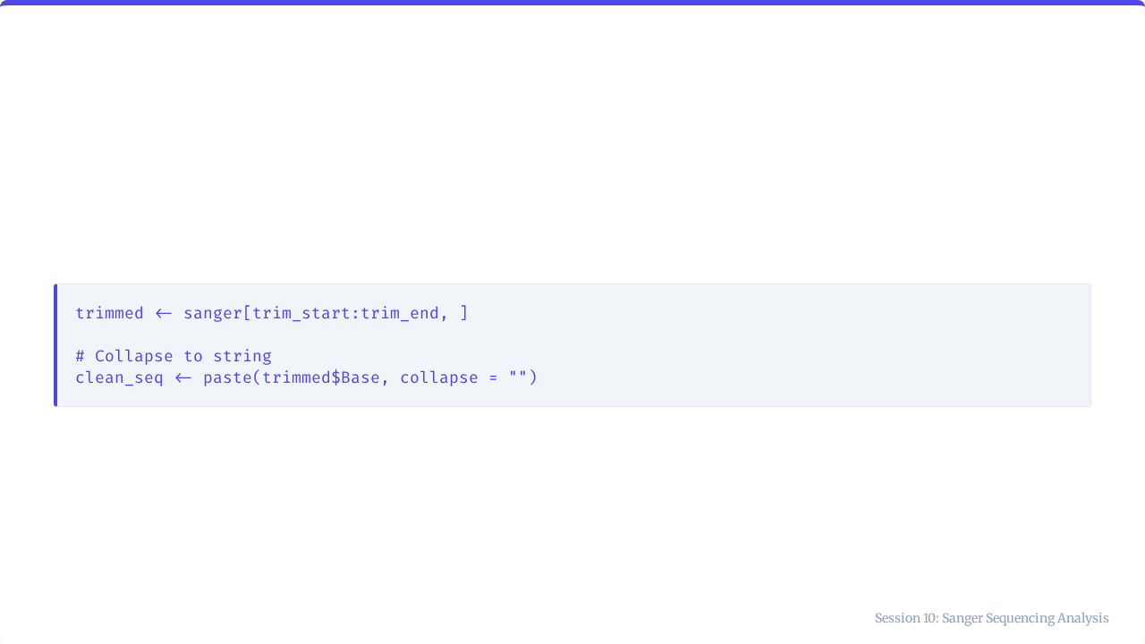
Step 5: Extract Clean Sequence
Compare the original length vs trimmed length. Did you improve the overall quality?

Slide 40

Session 10 Complete
You are ready for Assessment 3.

